Slide 1

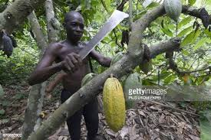
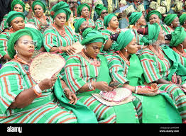
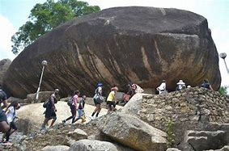
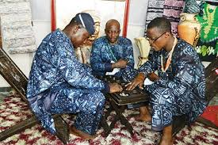
BUDGET OF RESTORATION
OGUN STATE 2022 CITIZENS BUDGET

Slide 2
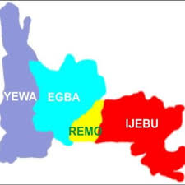
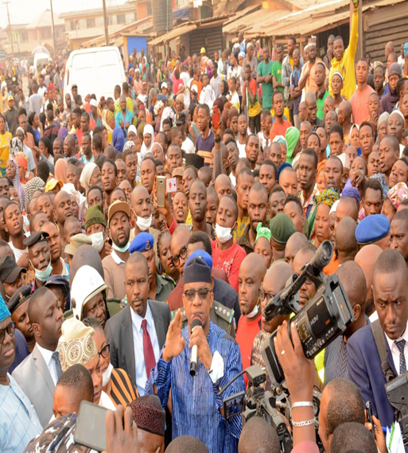
BUDGET
OF RESTORATION
INTRODUCTION
Definition & Objective: The Citizens’ Budget is a simplified version of the government budget presented by the government that prepares and implements the budget. It is a guide that allows government to explain in plain language, so a lay citizen can relate with the objectives and major policies of the budget. It is proactive and reasonably timed so that it promotes citizens’ engagement.
Its essence is to provide the average citizen with sufficient information to question the main budget. Its simplicity and conciseness differentiates it from the main budget. It is a form of liberation thereby takes the budget away from closed doors and demystifies it. The understanding on the part of the citizens will cause the populace to moderate their expectation as well as facilitate citizens’ oversight over the management of public funds.

Slide 3
INTRODUCTION CONT’D: BUDGET PROCESSES
The Budget Planning/ Preparation Stage
The Budget Approval Stage
The Budget Oversight/ Audit Stage
The Budget Implementation Stage
BUDGET
OF RESTORATION
ROLES OF THE EXECUTIVE AND LEGISLATURE IN THE BUDGET PROCESSES:
t
Presentation of Draft Budget to the House of Assembly: Pursuant to Section 121 of the 1999 Constitution (as amended), The Executive Governor shall present the draft budget to the Houser of Assembly as an Appropriation Bill in accordance with the Budget Calendar. The term “Appropriation” refers to an authorisation made by Law or other legislative approval, directing the payment for goods and services out of government funds under specified conditions or for specified purposes. Once approved by the Assembly, the Appropriation Bill is passed to the Governor for his assent. By this assent, the Bill becomes law. In the event that the Governor’s assent is not given within 30 days, then the Bill may return to the Assembly. If the House agrees to the Bill with a two-third majority , then it may be passed into Law without the Governor’s assent.

Slide 4



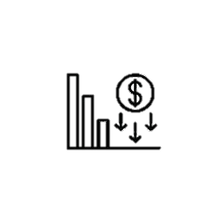

Macro-Economic and Fiscal Assumptions
BUDGET
OF RESTORATION
Ogun State inflation is projected to be at 11.24% in year 2022, 8.57% and 7.47% in the outer years 0f 2023 and 2022 respectively. The State GDP growth rate is expected to be 3.63%, 1.79% and 2.46% within the medium-term framework while the average real nominal GDP is expected to be 3,036.98 trillion within the medium term.
Envelope Size N’M
State GDP Growth Rate
State GDP (N’TR)
350,735
3.63%
2,977
Inflation Rate
Oil Production (Barrel)
11.24%
1.88

Slide 5
N103.97bn
f
BUDGET DEFICIT
N103.97bn
N350.74bn
BUDGET
AT A GLANCE
TOTAL BUDGET
TOTAL BUDGET FINANCING
FINANCING GAP (N0BN)
N246.77bn
TOTAL FUNDING SOURCES

Slide 6
GENERAL FRAMEWORK
BUDGET
OF RESTORATION
LINE ITEM | 2022 APPROVED BUDGET | 2022 FIRST QUARTER ACTUAL | % PERF. | 2021 APPROVED BUDGET | 2021 ACTUAL (UNAUDITED) | % PERF.
 | (N) | (N) | % | (N) | (N) | %
TOTAL BUDGET EXPENDITURE | 350,735,149,739.57 | 51,396,947,384.58 | 14.65 | 338,610,943,021.86 | 186,441,023,399.35 | 55.06
TOTAL BUDGET REVENUE,GRANTS AND OPENING CASH AND CASH EQUIVALENTS | 246,769,589,739.57 | 71,228,183,437.52 | 28.86 | 204,243,376,163.44 | 162,766,533,493.30 | 79.69
BUDGET DEFICIT | 103,965,560,000.00 |  |  | 134,367,566,858.42 | 23,674,489,906.05 | 17.62
TOTAL BUDGET FINANCING | 103,965,560,000.00 | 6,247,089,743.65 | 6.00 | 134,367,566,858.42 | 89,153,365,731.26 | 66.35
FINANCING GAP | - | - | - | - | - | -

Slide 7

WHERE WILL THE FUNDING COME FROM
OPENING CASH & CASH EQUIVALENTS
N10,312,247,982.36
STATUTORY ALLOCATION
N43,096,470,300.08
INTERNALLY GENERATED REVENUE
N153,174,462,525.27
BUDGET
OF RESTORATION
N
Bal.
EXCESS CRUDE/EXCHANGE GAIN/NNPC REFUND
N3,311,846,749.58
VALUE ADDED TAX N26,593,542,182.28
CAPITAL RECEIPTS
N114,246,580,000.00
Internal Loan – N75,328,887,000.00
External Loan and Drawdown – N28,636,673,000.00
Grants – N10,281,020,000.00

Slide 8

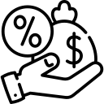

SOURCE OF CAPITAL RECEIPTS
BUDGET
OF RESTORATION
N’BN75,328,887,000.00
N’BN28,636,673,000.00
N’BN10,281,020,000.00
A. INTERNAL LOANS
B. EXTERNAL LOANS
C. GRANTS
 |  | N’MILLION
1 | BOND | 30,000
2 | CBN INTERVENTION LOAN TO CUSHION THE EFFECT OF REPAYMENT OF INTERVENTION LOANS | 12,000
3 | COMMERCIAL AGRICULTURAL CREDIT SCHEME | 5,000
4 | CONCESSIONARY LOANS | 28,328
 | TOTAL | 75,328
 |  | N’MILLION
1 | OGSTEP | 16,918
2 | RAAMP | 2,050
3 | NEWMAP | 410
4 | NIGERIA FOR WOMEN | 2,050
5 | AFDB (WATER PROJECTS) | 4,556
6 | NIGERIA CARES | 2,050
7 | FG/IFAD | 598
 | TOTAL | 28,636
 |  | N’MILLION
1 | SFTAS | 3,937
2 | SOCIAL SAFETY NET PROGRAMMES | 1,835
3 | TETFUND | 2,535
4 | SUSTAINABLE DEVELOPMENT GOALS | 600
5 | BASIC HEALTH CARE PROJECT | 373
6 | COVID-19 PREPAREDNESS & RESPONSE PROJECT (CoPREP) | 1,000
 | TOTAL | 10,281

Slide 9

2022 – 2024 REVENUE PROJECTIONS
BUDGET
OF RESTORATION
MDAS | 2022 | 2023 | 2024
 | N' M | N' M | N' M
Internally Generated Revenue (OGIRS) | 56,304,087,574.38 | 66,581,981,155.38 | 68,539,899,972.90
Internally Generated Revenue (MDAs) | 96,870,374,950.89 | 105,875,496,694.50 | 120,227,821,145.19
Total Internal Generated Revenue | 153,174,462,525.27 | 172,457,477,849.88 | 188,767,721,118.09
External Loans | 28,636,673,000.00 | 13,329,875,000.00 | 15,790,775,000.00
Internal Loans | 75,328,887,000.00 | 80,206,790,700.46 | 81,445,377,440.15
Sub-total Loans | 103,965,560,000.00 | 93,536,665,700.46 | 97,236,152,440.15
Total Grants | 10,281,020,000.00 | 3,798,000,000.00 | 3,923,000,000.00
Total Capital Receipts | 114,246,580,000.00 | 97,334,665,700.46 | 101,159,152,440.15
Statutory Allocation | 46,408,317,049.66 | 52,919,051,777.18 | 56,495,688,974.21
VAT | 26,593,542,182.28 | 36,764,957,960.77 | 42,309,501,215.55
Total FAAC | 73,001,859,231.94 | 89,684,009,737.95 | 98,805,190,189.76
Opening Balance | 10,312,247,982.36 | 10,549,429,685.95 | 10,895,560,865.59
GRAND TOTAL | 350,735,149,739.57 | 370,025,582,974.24 | 399,627,624,613.59

Slide 10
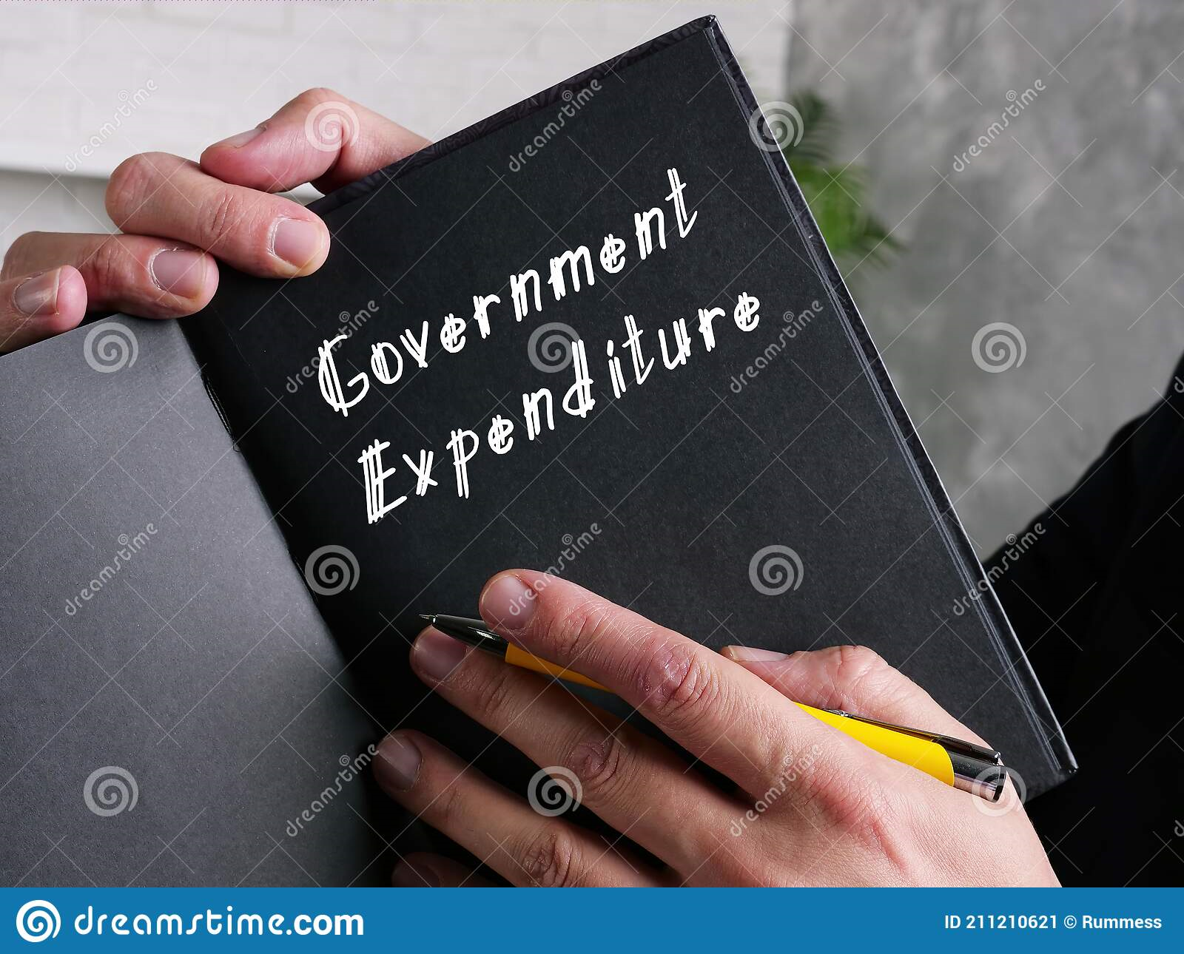
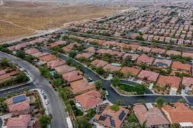
HOW THE FUND WILL BE EXPENDED?
BUDGET
OF RESTORATION
Personnel Cost
N93,091,823,954.47
TOTAL
EXPENDITURE
Overhead Cost N60,088,651,993.30
Capital Expenditure
N197,554,673,791.80

Slide 11
?
WHERE
DOES THE MONEY GO
BUDGET
OF RESTORATION
TOTAL EXPENDITURE
N350.73B
PERSONNEL COST
N93.09B
CAPITAL EXPENDITURE
N197.55B
OVERHEAD COST
N32.07B
PUBLIC DEBT CHARGES
N28.01B
PARTICULAR | ESTIMATES (N)
SALARIES & ALLOWANCES | 75,879,021,496.48
CRFC | 17,212,802,457.99
TOTAL PERSONNEL COST | 93,091,823,954.47
OVERHEAD | 32,075,256,744.27
PDC | 28,013,395,249.03
TOTAL RECURRENT EXPENDITURE | 153,180,475,947.77
CAPITAL EXPENDITURE | 197,554,673,791.80
TOTAL EXPENDITURE | 350,735,149,739.57

Slide 12
2022 & 2021 RECURRENT AND CAPITAL EXPENDITURE COMPARISON
 | 2022 |  | 2021
 | N’M | % | N'M | %
RECURRENT | 153,180 | 44 | 166,712 | 49
CAPITAL | 197,554 | 56 | 171,898 | 51
TOTAL | 350,734 | 100 | 338,610 | 100

Slide 13
SUMMARY OF APPROVED ESTIMATES FROM 2020-2022
DETAILS | 2020 REVISED ESTIMATES |  | 2021 APPROVED ESTIMATES |  | 2022 APPROVED ESTIMATES
 | N | % | N | % | N | %
Capital Expenditure | 148,426,487,252 | 62.61 | 162,363,053,141 | 47.95 | 197,554,673,792 | 56.33
Recurrent Expenditure | 132,481,051,125 | 37.39 | 176,247,889,881 | 52.05 | 153,180,475,948 | 43.67
Total Budget | 280,907,538,376 | 100.00 | 338,610,943,022 | 100.00 | 350,735,149,740 | 100.00
Funding Sources:
Opening Balance | 21,305,456,471 | 7.58 | 18,405,526,772 | 5.44 | 10,312,247,982 | 2.94
Internally Generated Revenue | 113,552,327,272 | 40.42 | 121,806,876,776 | 35.97 | 153,174,462,525 | 43.67
Statutory Allocation | 23,685,197,565 | 8.43 | 39,675,563,607 | 11.72 | 43,096,470,300 | 12.29
Excess Crude/ Exchange Gains etc. | - | 0.00 | - | 0.00 | 3,311,846,750 | 0.94
Value Added Tax | 14,101,725,231 | 5.02 | 19,195,453,009 | 5.67 | 26,593,542,182 | 7.58
Total Revenue (Excluding Opening Cash and Cash Equivalents) | 151,339,250,068 | 53.88 | 180,677,893,392 | 53.36 | 226,176,321,757 | 64.49
Capital Receipts:
Internal Loans | 65,000,000,000 | 23.14 | 95,709,566,858 | 28.27 | 75,328,887,000 | 21.48
External Loans | 26,100,000,000 | 9.29 | 38,658,000,000 | 11.42 | 28,636,673,000 | 8.16
Grants | 17,162,831,837 | 6.11 | 5,159,956,000 | 1.52 | 10,281,020,000 | 2.93
Sub-Total | 108,262,831,837 | 38.54 | 139,527,522,858 | 41.21 | 114,246,580,000 | 32.57
GRAND TOTAL | 280,907,538,376 | 100.00 | 338,610,943,022 | 100.00 | 350,735,149,740 | 100.00
BUDGET
OF RESTORATION

Slide 14
TOP MINISTRY EXPENDITURE ALLOCATION
BUDGET
OF RESTORATION
MINISTRY | TOTAL RECURRENT (N) | CAPITAL EXPENDITURE (N)
Ministry of Works and Infrastructure | 225,777,887.91 | 77,828,878,604.02
Ogun State Primary Health Care Development Board | 261,140,673.78 | 7,666,650,236.03
Ogun State Rural Access and Agricultural Marketing Project | 269,817,918.58 | 5,435,156,368.34
Ministry of Education, Science & Technology | 2,420,625,432.29 | 4,649,820,726.90
Ogun State Water Supply Project | - | 4,557,031,000.00
Ogun State Property & Investment Corporation (OPIC) | 692,024,702.33 | 4,399,997,886.88
Ogun State Hospitals Management Board | 3,226,391,250.94 | 4,020,008,422.29
Ministry of Health | 1,505,731,770.49 | 3,939,468,965.15
Ogun State Housing Project | 20,000,000.00 | 3,530,443,617.90
Ministry of Agriculture | 1,306,368,480.84 | 3,339,833,420.64
Office of the Governor | 6,695,444,348.21 | 3,113,442,249.88
State House of Assembly | 3,769,754,254.08 | 2,885,589,687.61
Ministry of Finance | 3,202,278,877.58 | 2,291,377,377.19
Ogun State Housing Corporation | 259,111,188.92 | 2,148,781,905.89
Ministry of Housing | 274,868,206.83 | 2,109,501,301.56
Ministry of Special Duties & Inter-governmental Affairs | 430,850,101.79 | 2,092,179,793.51
GRAND TOTAL | 24,560,185,094.57 | 134,008,161,563.79

Slide 15
2022 ESTIMATES FUNCTIONAL CLASSIFICATION OF MDAs UNDER IPSAS
BUDGET
OF RESTORATION
S/N | FUNCTIONAL CLASSIFICATION | SALARIES & ALLOWANCES (N) | OVERHEAD COST (N) | CAPITAL EXPENDITURE (N) | TOTAL EXPENDITURE (N) | REVENUE (N)
1 | GENERAL PUBLIC SERVICES | 12,897,578,454.96 | 45,471,286,419.49 | 24,592,210,100.42 | 82,961,074,974.87 | 58,696,484,691.34
2 | PUBLIC ORDER AND SAFETY | 2,435,169,399.64 | 3,651,394,541.08 | 3,094,506,116.91 | 9,181,070,057.64 | 320,601,611.53
3 | ECONOMIC AFFAIRS | 5,972,270,013.48 | 1,707,150,930.29 | 103,019,483,246.51 | 110,698,904,190.27 | 3,947,239,990.19
4 | ENVIRONMENTAL PROTECTION | 513,997,965.03 | 1,001,819,670.95 | 2,400,350,753.79 | 3,916,168,389.78 | 667,512,527.19
5 | HOUSING AND COMMUNITY AMENITIES | 3,328,305,226.65 | 854,490,053.74 | 21,658,690,891.82 | 25,841,486,172.21 | 66,752,089,642.33
6 | HEALTH | 10,634,326,942.46 | 1,388,940,707.97 | 22,050,247,323.52 | 34,073,514,973.95 | 2,392,536,593.28
7 | RECREATION, CULTURE AND RELIGION | 2,171,505,448.61 | 861,141,445.62 | 3,344,893,002.67 | 6,377,539,896.90 | 1,461,024,191.69
8 | EDUCATION | 36,637,723,777.29 | 4,288,156,345.34 | 15,275,142,584.83 | 56,201,022,707.46 | 18,925,752,152.73
9 | SOCIAL PROTECTION | 18,500,946,726.35 | 864,271,878.81 | 2,119,149,771.34 | 21,484,368,376.50 | 11,221,125.00
 | GRAND TOTAL | 93,091,823,954.47 | 60,088,651,993.30 | 197,554,673,791.80 | 350,735,149,739.57 | 153,174,462,525.27

Slide 16
2022 ESTIMATES ADMINISTRATIVE CLASSIFICATION OF MDAs UNDER IPSAS
BUDGET
OF RESTORATION
S/N | ADMINISTRATIVE CLASSIFICATION | SALARIES & ALLOWANCES (N) | OVERHEAD COST (N) | CAPITAL EXPENDITURE (N) | TOTAL EXPENDITURE (N) | REVENUE (N)
1 | ADMINISTRATION SECTOR | 30,794,985,970.63 | 15,885,329,845.70 | 25,663,601,777.20 | 72,343,917,593.52 | 1,583,390,436.84
2 | ECONOMIC SECTOR | 10,356,547,971.42 | 35,443,680,350.05 | 128,643,982,529.03 | 174,444,210,850.50 | 129,210,823,192.18
3 | LAW AND JUSTICE SECTOR | 2,205,337,932.00 | 1,077,751,130.25 | 741,132,742.41 | 4,024,221,804.66 | 320,601,611.53
4 | REGIONAL SECTOR | - | 20,000,000.00 | 78,105,761.52 | 98,105,761.52
5 | SOCIAL SERVICES SECTOR | 49,734,952,080.42 | 7,661,890,667.30 | 42,427,850,981.65 | 99,824,693,729.37 | 22,059,647,284.72
 | GRAND TOTAL | 93,091,823,954.47 | 60,088,651,993.30 | 197,554,673,791.81 | 350,735,149,739.57 | 153,174,462,525.27

Slide 17
2022 ISEYA CLASSIFICATION OF MDAs
BUDGET
OF RESTORATION
S/N | ISEYA CLASSIFICATION | SALARIES & ALLOWANCES (N) | OVERHEAD COST (N) | CAPITAL EXPENDITURE(N) | TOTAL EXPENDITURE (N) | REVENUE (N)
1 | INFRASTRUCTURE | 3,120,075,504.71 | 1,157,226,865.61 | 94,935,361,962.80 | 99,212,664,333.12 | 2,833,872,372.29
2 | SOCIAL WELLBEING | 35,439,799,876.33 | 5,216,918,513.59 | 48,176,060,711.43 | 88,832,779,101.35 | 70,143,961,499.32
3 | EDUCATION | 36,637,723,777.29 | 4,288,156,345.34 | 15,275,142,584.83 | 56,201,022,707.46 | 18,925,752,152.73
4 | YOUTH EMPOWERMENT, CULTURE & RELIGION | 2,100,277,177.03 | 831,429,755.22 | 2,691,482,745.19 | 5,623,189,677.43 | 1,461,024,191.69
5 | AGRICULTURE | 2,946,000,402.30 | 663,388,690.51 | 9,719,407,390.34 | 13,328,796,483.15 | 1,113,367,617.90
6 | ENABLERS | 12,847,947,216.81 | 47,931,531,823.03 | 26,757,218,397.21 | 87,536,697,437.05 | 58,696,484,691.34
 | GRAND TOTAL | 93,091,823,954.47 | 60,088,651,993.30 | 197,554,673,791.80 | 350,735,149,739.56 | 153,174,462,525.27

Slide 18
OGUN STATE SECTORAL CLASSIFICATION OF MDAs
BUDGET
OF RESTORATION
S/N | SECTORAL CLASSIFICATION | SALARIES & ALLOWANCES (N) | OVERHEAD COST (N) | CAPITAL EXPENDITURE (N) | TOTAL EXPENDITURE (N) | REVENUE (N)
1 | EDUCATION | 36,637,723,777.29 | 4,288,156,345.34 | 15,275,142,584.83 | 56,201,022,707.46 | 18,925,752,152.73
2 | HEALTH | 10,634,326,942.46 | 1,388,940,707.97 | 22,050,247,323.52 | 34,073,514,973.95 | 2,392,536,593.28
3 | HOUSING | 3,857,545,300.11 | 1,807,556,789.26 | 23,197,165,357.94 | 28,862,267,447.31 | 67,419,602,169.51
4 | AGRICULTURE / INDUSTRY | 3,500,634,181.88 | 793,060,184.81 | 10,920,509,427.71 | 15,214,203,794.40 | 2,923,401,217.90
5 | RURAL INFRASTRUCTURE | 1,081,447,757.58 | 612,706,272.67 | 90,888,202,602.07 | 92,582,356,632.32 | 83,054,830.63
6 | RECREATION, CULTURE AND RELIGION | 2,171,505,448.61 | 861,141,445.62 | 3,344,893,002.67 | 6,377,539,896.90 | 1,461,024,191.69
7 | SOCIAL PROTECTION | 18,463,126,995.97 | 829,271,878.81 | 1,999,150,209.86 | 21,291,549,084.64 | 11,221,125.00
8 | GENERAL PUBLIC SERVICE (EXECUTIVE ORGANS) | 4,609,113,026.68 | 6,249,000,000.00 | 3,686,272,467.54 | 14,544,385,494.22 | 103,753,742.85
9 | FINANCIAL & FISCAL AFFAIRS | 2,139,168,674.73 | 5,326,099,915.36 | 5,558,913,837.30 | 13,024,182,427.40 | 58,533,968,926.27
10 | GENERAL PERSONNEL SERVICES | 535,818,984.02 | 177,278,945.60 | 325,359,283.47 | 1,038,457,213.09 | 57,520,522.23
11 | PUBLIC ORDER AND SAFETY | 668,551,547.86 | 2,685,999,623.23 | 2,575,556,621.64 | 5,930,107,792.73 | 149,672,651.31
12 | ECONOMIC AFFAIRS | 1,412,765,695.97 | 385,137,408.25 | 2,192,647,065.88 | 3,990,550,170.10 | 940,783,941.66
13 | JUDICIARY | 1,766,617,851.78 | 965,394,917.85 | 518,949,495.28 | 3,250,962,264.91 | 170,928,960.21
14 | LEGISLATURE | 1,375,843,100.00 | 2,553,975,422.73 | 3,085,573,803.87 | 7,015,392,326.60 | 1,241,500.00
15 | STATEWIDE | 4,237,634,669.53 | 31,164,932,135.80 | 11,936,090,708.24 | 47,338,657,513.57 | 0.00
 | GRAND TOTAL | 93,091,823,954.47 | 60,088,651,993.30 | 197,554,673,791.80 | 350,735,149,739.57 | 153,174,462,525.27

Slide 19
PROGRAMME CLASSIFICATION OF MDAs UNDER IPSAS
BUDGET
OF RESTORATION
S/N | PROGRAMME CLASSIFICATION | SALARIES & ALLOWANCES (N) | OVERHEAD COST (N) | CAPITAL EXPENDITURE (N) | TOTAL EXPENDITURE (N) | REVENUE (N)
1 | ECONOMIC EMPOWERMENT THROUGH AGRICULTURE (GENERAL) | 2,222,444,162.89 | 597,613,141.29 | 8,704,655,799.20 | 11,524,713,103.38 | 775,288,386.65
2 | SOCIETAL RE-ORIENTATION (GENERAL) | 922,346,907.08 | 332,474,348.83 | 702,464,883.78 | 1,957,286,139.69 | 1,115,522,725.29
3 | POVERTY ALLEVIATION | 644,501,259.46 | 152,480,138.01 | 1,093,287,620.11 | 1,890,269,017.58 | 39,643,612.50
4 | IMPROVEMENT TO HUMAN HEALTH (GENERAL) | 10,634,326,942.46 | 1,388,940,707.97 | 22,050,247,323.52 | 34,073,514,973.95 | 2,392,536,593.28
5 | ENHANCING SKILLS AND KNOWLEDGE (GENERAL) | 36,637,723,777.29 | 4,288,156,345.34 | 15,275,142,584.83 | 56,201,022,707.46 | 18,925,752,152.73
6 | HOUSING AND URBAN DEVELOPMENT (GENERAL) | 2,159,639,953.50 | 643,239,443.75 | 14,312,402,618.47 | 17,115,282,015.72 | 66,604,508,887.95
7 | GENDER (GENERAL) | 597,066,398.99 | 794,271,878.81 | 1,884,165,962.20 | 3,275,504,240.00 | 11,221,125.00
8 | YOUTH (GENERAL) | 891,233,770.73 | 181,500,000.00 | 1,669,842,477.95 | 2,742,576,248.68 | 89,036,586.52
9 | ENVIRONMENTAL IMPROVEMENT (GENERAL) | 1,211,644,793.64 | 1,056,819,670.95 | 3,272,152,023.97 | 5,540,616,488.57 | 1,005,591,758.44
10 | WATER RESOURCES AND RURAL DEVELOPMENT (GENERAL) | 778,822,264.67 | 417,074,685.92 | 14,084,006,517.09 | 15,279,903,467.68 | 114,427,454.38
11 | INFORMATION AND COMMUNICATION TECHNOLOGY (GENERAL) | 71,228,271.58 | 29,711,690.40 | 653,410,257.48 | 754,350,219.46 | -
12 | GROWING PRIVATE SECTOR (GENERAL) | 741,619,377.63 | 229,535,454.56 | 1,722,146,612.17 | 2,693,301,444.36 | 1,883,362,854.16
13 | REFORM OF GOVERNMENT AND GOVERNANCE (GENERAL) | 35,014,715,484.26 | 49,806,261,902.15 | 31,431,758,519.96 | 116,252,735,906.37 | 60,147,809,332.75
14 | POWER (GENERAL) | 246,617,349.27 | 20,000,000.00 | 2,035,413,180.58 | 2,302,030,529.85 | -
15 | ROAD (GENERAL) | 317,893,241.02 | 150,572,585.31 | 78,663,577,410.49 | 79,132,043,236.82 | 69,761,055.63
 | GRAND TOTAL | 93,091,823,954.47 | 60,088,651,993.29 | 197,554,673,791.80 | 350,735,149,739.57 | 153,174,462,525.27

Slide 20
Y2022 KEY CAPITAL PROJECTS-I
BUDGET
OF RESTORATION
AGENCY | PROJECTS | AMOUNT (N)
HOSPITAL MANAGEMENT BOARD | Renovation and expansion of the following General hospitals, Community mental hospital and Dental centres in the three senatorial districts in the State; | 2,683,352,885.97
 | OGUN CENTRAL SENATORIAL DISTRICT:(General Hospital- Owode-Egba, Olikoye Ransome-Kuti Memorial Hospital Abeokuta Hansen/General Medical Clinic, Iberekodo)
 | OGUN EAST SENATORIAL DISTRICT: General Hospital Odogbolu, General Hospital, Odelemo, General Hospital, Omu Ijebu)
 | OGUN WEST SENATORIAL DISTRICT :General Hospital Ipokia, General Hospital Imeko, General Hospital Ayetoro,
 | Community Mental Hospital, Ilaro Expansion and Construction of Dental Laboratories)
Olabisi Onabanjo University Teaching Hospital | Construction / Provision of office building | 2,536,791,113.55
 | Rehabilitation and reconstruction of maternity ward
 | Establishment of basic school of nursing
 | Residency training complex
 | Procurement of adequate modern medical equipment for
 | all clinical services in the Hospital to replace the obsolete ones
Primary Health care Development Board | Upgrade of 160 Primary Health Care Centres in the state | 6,808,954,098.00
 | Procurement of Health/Medical equipment for the State
MINISTRY OF ENVIRONMENT | Execution of designs already prepared on the remediation and rehabilitation of some of the already environmentally degraded areas of the State either by flood or erosion, so as to prevent further degradation and arrest gully formation that could cause damages to the eco-system of the affected areas and counterpart funding for the West African Coastal Area projects | 901,406,334.07
Nigeria Erosion and Watershed Management Project (NEWMAP) | Desilting and clearing of waterways in the Three (3) Senatorial Districts | 761,098,225.00
 | Procurement of Swamp Buggy, Procurement of Carrier Lowbed

Slide 21
Y2022 KEY CAPITAL PROJECTS-II
BUDGET
OF RESTORATION
AGENCY | PROJECTS | AMOUNT (N)
MINISTRY OF AGRICULTURE | Establishment of 50HA of Oil Plantation, Cashew Plantation, Intervention on Anchor Borrowers Programme, Clearing of 100HA of land at Ikenne, Green House development project, Procurement of Fogging machine, Motorise sprayer, MF tractor, Arrower and Slasher, Fish farm estate, and Biological Assets, etc. | 2,489,129,590.49
OGUN N-CARES FADAMA | Agricultural Assets for production and mitigation of food loss and wastages. | 660,585,100.01
BUREAU OF ELECTRICAL ENGINEERING SERVICES (BEES) | Procurement and Installation of 150 units of 500KVA, 33/.415KV (Unit price of ₦6,200,000 and installation price of ₦4,100,000) and 60 units of 300KVA, 33/.415KV (unit price of ₦4,700,000 and installation price of ₦3,200,000) Power Distribution Transformers | 2,019,000,000.00
MINISTRY OF WORKS AND INFRASTRUCTURE | Construction of Agro Cargo Airport | 77,647,109,653.53
 | Cost of reconstruction and rehabilitation of Roads across the State
SPECIAL DUTIES & INTER- GOVERNMENT AFFAIRS | Construction of Ultra- Modern Fire Safety service station across the state (Inter - change, Obantoko, Ijemo, Abeokuta South LG, IKENNE/ ODOGBOLU, IPOKIA, AKUTE - ALAGBOLE AXIS and Ita -Oshin/Oke - Ata Axis Abeokuta North L.G | 598,500,001.04
 | Purchase of 5 nos Fire Fighting Equipment ( Man Diesel)

Slide 22
Y2022 KEY CAPITAL PROJECTS-III
BUDGET
OF RESTORATION
AGENCY | PROJECTS | AMOUNT (N)
MINISTRY OF TRANSPORTATION | Construction of parking lots and security post, rehabilitation of offices and set up of out stations | 56,508,177.88
 | Preliminaries on construction of red line metro rail projects at Ijoko and IFO/PAPALANTO | 136,060,605.24
 | Gateway airport project sited in Iperu/ Isara in Remo area of the state | 10,735,000.00
 | Design and installation of solar powered wireless intelligent traffic system and rehabilitation/repairs of existing solar traffic lights | 156,957,000.00
 | Provision of directional signs, pavement marking of roads, construction of Sagamu to Berger bus mass transit bus stop/ layby, construction of bus stop/ layby for extension of bus mass transit from Ita-Oshin-Adatan to Obantoko and Osiele, traffic signages and installation of height restriction barriers at approaches to overhead bridges in Ogun State | 249,331,757.80
MINISTRY OF RURAL DEVELOPMENT | Construction of Engineered (Chemical Treated) Earth roads and bridges across the state | 1,015,968,366.06
 | Construction/Provision for electrification of selected adjoining rural communities 1 in each Senatorial District | 321,242,583.18

Slide 23
Y2022 KEY CAPITAL PROJECTS-IV
BUDGET
OF RESTORATION
AGENCY | PROJECTS | AMOUNT (N)
RURAL ACCESS AND AGRICULTURAL MARKETING PROJECT (RAAMP) | Physical Improvement of Agro-Logistics Centre (markets with modern agro logistics facilities) under Component A.1c of the project component analysis. | 465,471,684.17
 | Physical improvement/upgrading of Rural Roads 60km of rural roads as per project development objective under Component A.1a of the project component analysis | 2,495,951,533.71
 | Backlog Maintenance of 70km Roads of rural roads as per project development objective under Component B.1a of the project component analysis | 729,459,370.24
 | Spot Improvement of 100km roads of rural roads as per project development objective under Component B.1b of the project component analysis | 1,001,069,814.83
HOUSING PROJECT | Construction of 2-bedroom bungalow apartment in various locations across the state. | 3,530,443,617.90
 | Development of new low-cost residential estates in different locations state-wide
WATER CORP0RATION | Construction of water distribution network to improve the population with access to potable water supply in Abeokuta, Ayetoro and Ijebu-Ode | 736,001,277.79
 | Complete Rehabilitation of Ogere Water Treatment Plant (B) and equipment to include provision of river bed batteries of boreholes to improve the output capacity from 3.0mld to 6.8mld | 672,842,271.81
OPIC | Completion of 12 Unit 4 B/RM Semi-detached to carcass level @ (PHASE ll KING'S COURT ESTATE) | 2,146,380,460.34
 | Opening up of Internal Access Road at Agbara and Construction of Internal Road at King’s Court Estate Phase II | 466,191,396.35

Slide 24

www.ogunstate.gov.ng
https://archive.ogunstate.gov.ng/download-category/budget-execution/
https://archive.ogunstate.gov.ng
BUDGET
OF RESTORATION
Regular payment of taxes etc. For more details on tax-related stimuli, please visit – www.ogunstaterevenue.com
Timely provision of information to security agencies.
Monitoring of on-going Government projects and reporting observed lapses to appropriate Government Agencies.
Patronage and protection of public facilities and infrastructure.
Keep themselves abreast of the State Budgetary information and provide feedback to the right channel through the State Official website.
CITIZENS’
ROLE
Visit Budget Execution Archives, Ogun State Government official website for the Ogun State approved Budget 2022 Town Hall Meetings held in October 2021.

